Slide 1
CYBR 520
Module 4: Classifying and Clustering
Chapter 2: Machine learning and security- Protecting systems with data and algorithms***

Slide 2
Please refer to Module 4 on github to obtain the codes or refer to the book’s github repo

Slide 3
Note
This chapter is full of mathematical analysis of the ML algorithms.
We will NOT cover those portions since his is not the focus of this Module however, we will briefly explore the basics of each.

Slide 4
Topics
Machine Learning: Problems and Approaches
Machine Learning in Practice: A Worked Example.
Training Algorithms to Learn
Supervised Classification Algorithms
Practical Consideration in Classification
Clustering
Model Evaluation

Slide 5
Learning Objectives
At the end of this module, students are expected to:
Gain familiarity with supervised machine framework
Understand the different steps followed when developing a machine learning model
Conduct a simple fraud classification model in python

Slide 6
Introduction
In this module, we discuss the most useful Machine Learning (ML) techniques for security applications.
After covering some of the basic principles of machine learning, we offer up a toolbox of machine learning algorithms that you can choose from when approaching any given security problem.
We have tried to include enough detail about each technique so that you can know when and how to use it, but we do not attempt to cover all the nuances and complexities of the algorithms.

Slide 7
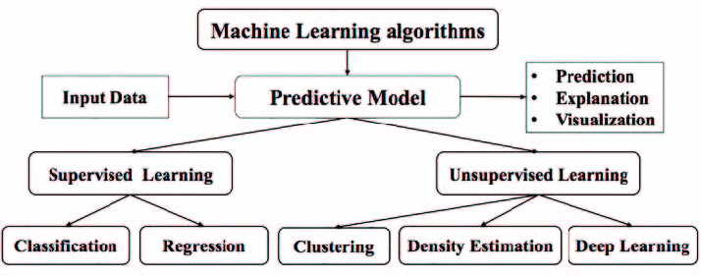
Source: A hybrid forecasting model of cassava price based on artificial neural network with support vector machine technique

Slide 8
Machine Learning: Problems and Approaches
Suppose that you are in charge of computer security for your company.
You install firewalls, hold phishing training, ensure secure coding practices, and much more.
But at the end of the day, all your CEO cares about is that you don’t have a breach. So, you take it upon yourself to build systems that can detect and block malicious traffic to any attack surface

Slide 9
Classification Tasks in Security
For every file sent through the network, does it contain malware?
For every login attempt, has someone’s password been compromised?
For every email received, is it a phishing attempt?
For every request to your servers, is it a denial-of-service (DoS) attack?
For every outbound request from your network, is it a bot calling its command-and-control server?

Slide 10
Classification Tasks in Security"
Thes tasks in the previous slide are all classification tasks—binary decisions about the nature of the observed event.
Your job can thus be rephrased as follows:
Classify all events in your network as malicious or legitimate.

Slide 11
The Power of Data
When phrased in this manner, the task seems almost hopeless;
How are you supposed to classify all traffic? But not to fear!
You have a secret weapon: data.

Slide 12
The Power of Data
Specifically, you have historical logs of binary files, login attempts, emails received, and inbound and outbound requests.
In some cases, you might even know of attacks in the past and be able to associate these attacks with the corresponding events in your logs.
Now, to begin solving your problem, you look for patterns in the past data that seem to indicate malicious attacks.

Slide 13
Algorithm Development
After you have found patterns in the data, the next step is to encode these patterns as an algorithm—that is, a function that takes as input data about whatever you’re trying to classify and outputs a binary response: “malicious” or “legitimate.”

Slide 14
Algorithm Development
In the previous example, this algorithm would be very simple: it takes as input the number of requests from an IP address over the 5 minutes prior to the request, and outputs “legitimate” if the number is less than 6,000 and “malicious” if it is greater than 6,000.
For example, you observe that when a single IP address is making more than 20 requests per second to your servers over a period of 5 minutes, it’s probably a DoS attack. (Maybe your servers went down under such a load in the past.)

Slide 15
Machine Learning Defined
At this point, you have learned from the data and created an algorithm to block bad traffic. Congratulations! But there should be something nagging at you: what’s special about the number 20?
Why isn’t the limit 19 or 21? Or 19.77? Ideally you should have some principled way of determining which one of these options, or in fact which real number, is “best,” this process is called machine learning.

Slide 16
Machine Learning Defined
More generally, machine learning is the process of using historical data to create a prediction algorithm for future data.
The task we just considered was one of classification: determine which class a new data point (the request) falls into.

Slide 17
Classification in Machine Learning
Classification can be binary, as we just saw, in which there are only two classes, or multiclass; for example, if you want to determine whether a piece of malware is ransomware, a keylogger, or a remote access trojan.

Slide 18
Is it only Classification?
We obviously can do more than just classification.
What if I want to predict the price of a product? Or the number of spams?
I am classifying anything here really?
We want to find a real-number numerical value

Slide 19
Regression in ML
Machine learning can also be used to solve regression problems, in which we try to predict the value of a real-number variable.
For example, you might want to predict the number of phishing emails an employee receives in a given month, given data about their position, access privileges, tenure in the company, security hygiene score, and so on.

Slide 20
Regression problems inputs
Regression problems for which the inputs have a time dimension are sometimes called time series analysis; for example, predicting the value of a stock tomorrow given its past performance, or the number of account sign-ins from the Seattle office given a known history.

Slide 21
Anomaly Detection
Anomaly detection is a layer on top of regression: it refers to the problem of determining when an observed value is sufficiently different from a predicted value to indicate that something unusual is going on.

Slide 22
Clustering and Supervised vs. Unsupervised Learning

Slide 23
Clustering and Learning Types
Machine learning is also used to solve clustering problems: given a bunch of data points, which ones are similar to one another?
For example, if you are trying to analyze a large dataset of internet traffic to your site, you might want to know which requests group together.
Some clusters might be botnets, some might be mobile providers, and some might be legitimate users.

Slide 24
Supervised Vs. Unsupervised
Machine learning can be supervised, in which case you have labels on historical data and you are trying to predict labels on future data.
Alternatively, machine learning can be unsupervised, in which case you have no labels on the historical data; you might not even know what the labels are that you’re trying to predict.

Slide 25
Example
If you have an unknown number of botnets attacking your network that you want to disambiguate from one another.
Classification and regression tasks are examples of supervised learning, and clustering is a typical form of unsupervised learning.

Slide 26
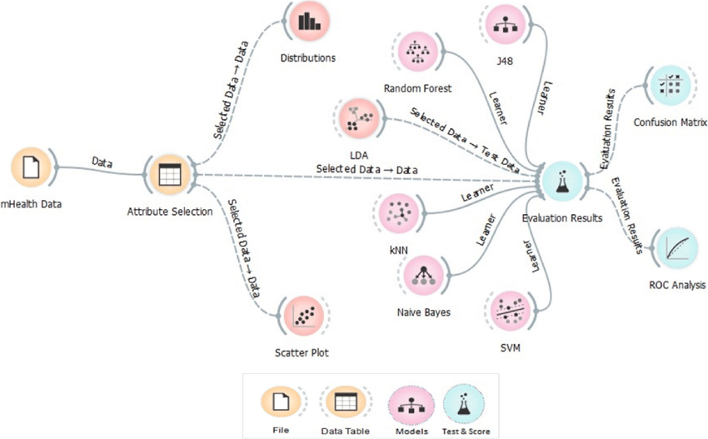

Slide 27
Machine Learning in Practice: A Worked Example

Slide 28
The problem
The goal is to classify whether a given transaction is fraudulent or not.
We need historical information from previous transactions, including fraudulent transactions

Slide 29
The data
payment_fraud.csv has 6 piece of information about transactions:
accountAgeDays: The age in days of the account initiating the transaction.
numItems: Number of items being purchased in this transaction.
LocalTime: Time of transaction.
paymentMethod: differeten types of method used to pay
paymentMethodAgeDays: The number of days this payment method has been in this account
Label: 0 if clean, 1 is if fraud

Slide 30
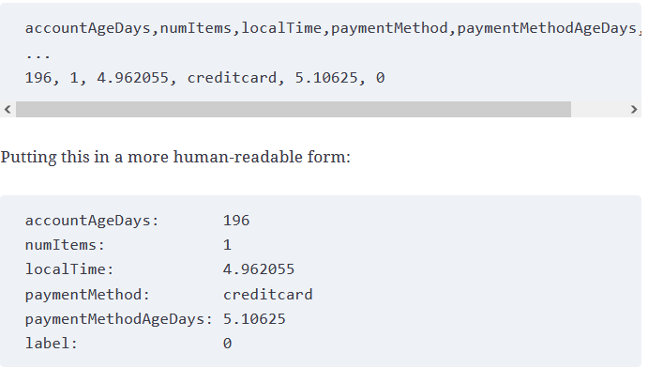
See notebook on Module 4 on GitHub.

Slide 31
We have logs. Then what?
How can we use this data to “learn” to classify whether a transaction is fraudulent or not?
Now, we could examine the data and come up with some rules, such as “If the payment method was added in the last day and the number of items is at least 10, the transaction is fraudulent.”

Slide 32
We have logs. Then what?
But such a rule might have too many false positives.
How can we use data to find the best prediction algorithm? This is what machine learning does.

Slide 33
Features
Each property of a transaction is called a feature in machine learning parlance.
What we want to achieve is to have a machine learning algorithm learn how to identify a fraudulent transaction from the five features in our dataset.
These are also known as dependent variables, attributes, predictors, input variables, dimensions

Slide 34
Labeled Datasets
Because the dataset contains a label for what we are aiming to predict, we call this a “labeled dataset” and can perform supervised learning on it. (If there had been no label, we could only have performed semi-supervised learning or unsupervised learning.)
The label is known as target variable, independent variable, or response variable

Slide 35
How to build the model
You give this data to a model (will be discussed later).
The model splits data into :
Training: Observation for the ML algorithm to teach itself what is fraud or not.
Testing: This data stays hidden during training, and is only used to Test whether the model built using the training can actual guess whether a transaction is fraudulent or not.

Slide 36
Training Algorithms to Learn
At its core, a machine learning algorithm takes in a training dataset and outputs a model.
The model is an algorithm that takes in new data points in the same form as the training data and outputs a prediction.

Slide 37
ML algorithm components
All machine learning algorithms are defined by three interdependent components:
A model family, which describes the universe of models from which we can choose
A loss function, which allows us to quantitatively compare different models
An optimization procedure, which allows us to choose the best model in the family

Slide 38
Model Families
Refer to the fraud dataset again: recall that we expressed our fraud dataset in terms of seven numerical features: four features from the raw data and three from the one-hot encoding of the payment method.

Slide 39
Model Families
We can thus think of each transaction as a point in a seven-dimensional real vector space, and our goal is to divide up the space into areas of fraud and nonfraud transactions. The “model” output by our machine learning algorithm is a description of this division of the vector space (decision boundaries).

Slide 40
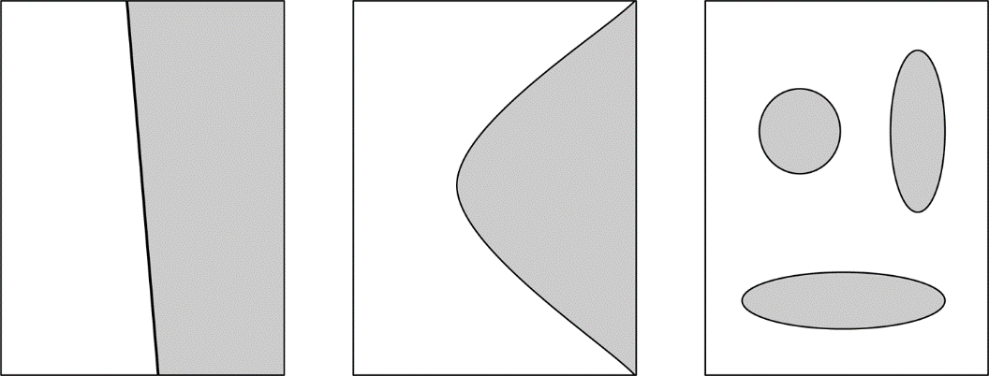
Decision Boundaries
In theory, the division of our vector space into fraud and nonfraud areas can be infinitely complex; in practice, most algorithms produce a decision boundary, which is a surface in the vector space.
Figure 2-1. Examples of two-dimensional spaces divided by a decision boundary
Notes:
If we want to be more granular, instead of mapping each point in the vector space to either “fraud” or “nonfraud,” we can map each point to a probability of fraud. In this case our machine learning algorithm outputs a function that assigns each point in the vector space a value between 0 and 1, to be interpreted in our example as the probability of fraud.

Slide 41
Linear Decision Boundary
Any given machine learning algorithm restricts itself to finding a certain type of decision boundary or probability function that can be described by a finite number of model parameters.
The simplest decision boundary is a linear decision boundary—that is, a hyperplane in the vector space.

Slide 42
Loss Functions
Now that we have restricted our choice of prediction algorithms to a certain parametrized family, we must choose the best one for the given training data.
How do we know when we have found the best algorithm?
We define the best algorithm to be one that optimizes some quantity computed from the data.

Slide 43
Loss Function
This quantity is called an objective function. In the case of machine learning, the objective function is also known as a cost function or loss function, because it measures the “cost” of wrong predictions or the “loss” associated with them.

Slide 44
Optimization
The last step in the machine learning procedure is to search for the optimal set of parameters that minimizes the loss function. To carry out this search we use an optimization algorithm.
There may be many different optimization algorithms available to you when fitting your machine learning model. See book for more details

Slide 45
Optimization
As with many things in data science, no optimization algorithm is one-size-fits-all, and there are no clear rules for which algorithm definitely performs better for certain types of problems.
A certain amount of trial-and-error experimentation is often needed to find an algorithm that suits your requirements and meets your needs.

Slide 46
Optimization
There are many considerations other than convergence or speed that you should take into account when selecting an optimizer.
Starting with the default or the most sensible option and iterating when you see clues for improvements is generally a good strategy.

Slide 47
Supervised Classification Algorithms
Logistic Regression (LogR)
Decision Trees (DT)
Decision Forests (DF)
Support Vector Machines (SVM(
Naive Bayes(NB)
k-Nearest Neighbors(KNN)
Neural Networks(NN)

Slide 48
Before LogReg: Linear Regression
Linear regression, taught in every introductory statistics course, is a powerful tool for predicting future outcomes based on past data.
The algorithm takes data consisting of input variables (expressed as vectors in a vector space) and a response variable (a real number) and produces a “best fit” linear model that maps each point in the vector space to its predicted response.

Slide 49
Logistic Regression
Logistic regression takes numerical feature vectors as input and predicts log odds for each data point.
Log odds can be converted into probabilities using the sigmoid function.
In the log odds space, the decision boundary is linear, and feature values affect the model's output score.

Slide 50
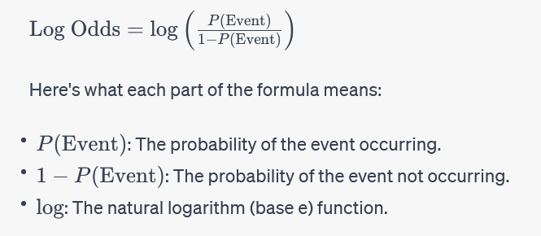
Log odds
Log odds," short for logarithm of odds, is a mathematical transformation used in statistics and probability theory.
It represents the logarithm of the ratio of the probability of an event happening to the probability of it not happening.

Slide 51
Why Not Linear Regression?
Linear regression is great for predicting numbers based on previous data.
However, it can't be used for classification problems, where we want to predict categories.
Linear regression predicts real numbers, and we need to predict categories like "yes" or "no."
If we try to use linear regression for classification, it gives us a line that doesn't work well as a classifier.

Slide 52
LogReg Assumptions
It assumes that the relationships between features and log odds are linear. If this isn't true, the model won't work well.
Features should not be strongly related to each other (multicollinearity).
Logistic regression often needs a larger amount of data compared to some other methods like linear regression.

Slide 53
Linear Relationship Assumption
Logistic regression assumes that the relationship between each feature and the log odds of the outcome is linear.
In simpler terms, it assumes that if you were to plot the values of a feature against the log odds of the outcome, you would get a straight line.
This assumption is known as the "linearity assumption.“ (See code on Module 4/ Lineatiry notebook.)

Slide 54
Assessing Linearity with R-squared
Data analysts and researchers often use R-squared as a tool to assess whether a linear regression model is appropriate for a given dataset. If the R-squared value is high, it suggests that the data has a linear relationship, and a linear regression model may be a good choice.
If the R-squared value is low, it may indicate that a linear model does not capture the underlying relationships in the data effectively, suggesting the presence of non-linearity. In such cases, alternative modeling techniques or transformations of the data may be considered.

Slide 55
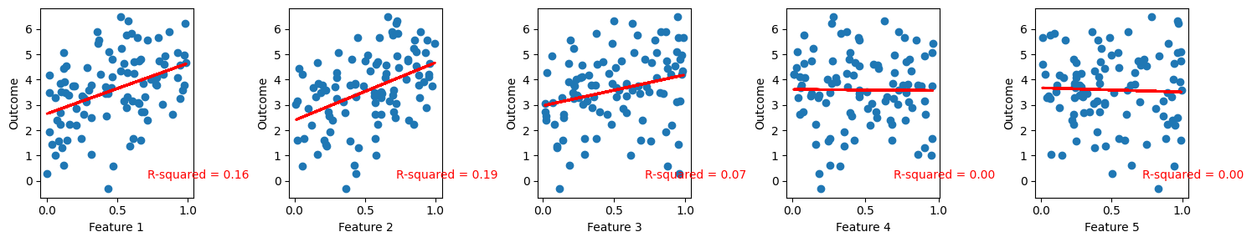
Assessing Linearity with R-squared
In summary, R-squared is a measure of how well a regression model explains the variance in the dependent variable.
In the context of linearity, a higher R-squared suggests a stronger linear relationship between the variables, while a lower R-squared suggests that the data may not follow a linear pattern, indicating the need for different modeling approaches.

Slide 56
Decision Trees
Decision trees are versatile supervised learning models.
Key property: Easy to interpret.
They are structured like binary trees.
Decision trees are intuitive and widely used in various fields.
Can predict both categorical values (classification trees) and real values (regression trees).
Handle numerical and categorical data without normalization or dummy variable creation.
Popular choice in machine learning.

Slide 57
Construction of Decision Trees
Decision trees are constructed in a top-down manner.
Starting at the root node, the dataset is split based on binary conditions.
Conditions divide the data into left and right child subsets.
Splitting conditions are selected to best separate data points.
Quality of splits can be measured using metrics like Gini impurity, variance reduction, or information gain.

Slide 58
Decision Trees: The Stopping Criteria
Decision tree construction stops based on criteria like:
When all leaves are pure (contain samples of the same class).
When a predefined maximum depth is reached.
When a child node has too few samples.
Output: A tree structure with nodes representing binary decisions and leaves representing classifications.

Slide 59
Decision Trees: The Stopping Criteria
Decision trees offer interpretability.
Predictions are expressed as a series of Boolean conditions.
Efficient for training and predictions (favorable for large datasets).
Every sample traverses at most the tree's height (efficient time complexity).

Slide 60
Limitations of Decision Trees
Overfitting: Trees can become overly complex and fail to generalize (pruning helps).
Inefficiency in representing certain relationships, e.g., XOR.
Less accuracy and robustness compared to some other techniques.
Sensitive to small changes in the training data.
Bias towards categorical variables with more values.
Greedy training does not guarantee an optimal tree (NP-complete problem).

Slide 61
Decision Forests
Ensemble: Combination of multiple classifiers.
Creates a more complex and often better-performing classifier.
Decision trees are often combined into ensembles called decision forests.
Two common types: Random Forests and Gradient-Boosted Decision Trees (GBDTs).

Slide 62
Random Forests
Random Forests: Ensembles of decision trees (typically tens to thousands).
Combats overfitting.
Predictions: Majority vote for classification or mean for regression.

Slide 63
Random Forests
Training Algorithm:
Randomly sample N data points.
At each split, randomly select m features from p available features.
Repeat steps until tree is trained.
Repeat for all trees.
Parallelizable and efficient but complex and less interpretable.

Slide 64
Gradient-Boosted Decision Trees (GBDTs)
GBDTs: Smart combinations of decision tree predictions.
Use gradient descent optimization on the loss function.
Add trees one at a time until stopping criteria met.
Improvements:
Constraints on trees (depth, nodes, samples).
Weighted contribution of trees (shrinkage).
Subsampling data and features.
Regularization techniques (L1 and L2).

Slide 65
Support Vector Machin (SVM)
SVM is a linear classifier like logistic regression but uses a different loss function.
It finds a hyperplane to separate two classes, aiming for the maximum-margin between classes.
The margin is the distance from the separating plane to the closest data points on each side.

Slide 66
SVM
Points within the margin are penalized based on their distance from it.
The mathematical representation of the loss function involves margin, distance, and a hyperparameter C.
SVM classifies new data points based on which side of the plane they fall on.

Slide 67
Naive Bayes (NB)
Naive Bayes is a classic statistical classifier that makes a strong assumption: it assumes features are chosen independently, even though this doesn't hold in reality.
Despite the "naive" assumption, Naive Bayes is effective for tasks like spam classification.
The core idea is to calculate the probability that a data point belongs to a specific class.
It uses Bayes' Theorem to express this as a conditional probability

Slide 68
NB Similarity to Logistic Regression
Naive Bayes is similar to logistic regression.
It implicitly involves an optimization algorithm in the probability estimate.
When taking logarithms, it becomes a linear classifier.

Slide 69
NB Challenges
Challenges arise in practice:
Handling cases where all examples of a feature are in one class (e.g., specific words only in spam messages) using smoothing.
Dealing with unseen features in validation or real-life scoring.
Mapping the score to a probability using a transformation but note that this probability might not be well-calibrated.
Techniques like Platt scaling or isotonic regression can improve probability estimates.

Slide 70
k-Nearest Neighbors (k-NN)
k-NN is a famous example of a "lazy" learning algorithm.
In lazy learning, most computations are done during classification, not training.
k-NN doesn't create general rules during training; instead, it remembers all training data to make decisions later.
It's simple:
Training: Store all feature vectors and labels.
Classification: Find the k nearest neighbors of a test sample and pick the most common label.

Slide 71
K-NN Pros and Cons
Pros:
Fast training phase (compared to other algorithms).
Good for teaching basic machine learning concepts.
Cons:
Large model sizes because they store all training data.
Slow classification (especially without optimization).
Sensitive to class imbalance.
Accuracy may suffer due to noisy, redundant, or unscaled features.
Choosing the right "k" parameter can be challenging.
Not suitable for high-dimensional data (curse of dimensionality).

Slide 72
Neural Networks (ANNs)
Neural networks (ANNs) have a long history, dating back to 1942 with McCulloch and Pitts.
They simulate how neurons in the brain work.
In the past, ANNs progressed slowly due to computing limitations.
Recent resurgence due to GPU acceleration and big data availability.

Slide 73
Biological Neurons vs. Artificial Neurons
Human brain: billions of neurons, complex connections.
Biological neurons: electrochemical signals, simple processing units.
ANNs: Modeled after biological neurons, use mathematical step functions (perceptrons).
Neural networks combine simple neurons to perform complex tasks.

Slide 74
Algorithm | Assumptions | When to Use | Considerations on Features
Logistic Regression | Linear relationship between features and log odds. | Binary classification, interpretable results. | Ensure features are relevant and scaled properly.
Linear Regression | Linear relationship between features and target variable. | Predicting continuous values. | Ensure features are relevant and scaled properly.
Decision Trees | Recursive binary splits based on feature conditions. | Classification or regression, interpretable results. | Can handle both categorical and numerical features.
Random Forests | Ensemble of decision trees with feature randomness. | Classification or regression, robust and accurate. | Can handle both categorical and numerical features.
Gradient Boosted Trees | Ensemble of decision trees optimized using gradient descent. | High predictive accuracy, handles complex relationships. | Sensitive to hyperparameters, may require tuning.
Support Vector Machines | Finds maximum-margin hyperplane for binary classification. | Binary classification, robust to outliers. | Need to select an appropriate kernel function.
Naive Bayes | Assumes features are conditionally independent given the class. | Text classification, simplicity. | May not perform well if independence assumption is violated.
k-Nearest Neighbors | Local lazy learning, classifies based on nearest neighbors. | Instances with clear decision boundaries. | Sensitive to distance metric and choice of 'k'.
Neural Networks | Modeled after the human brain, can capture complex patterns. | Complex tasks with large datasets. | Requires significant computational resources.

Slide 75
Practical Considerations in Classification
In theory, using a machine learning algorithm sounds pretty simple. You take your training data, organize it into a big matrix, and then let the computer do its magic to create a model. This model can be used to make predictions about new data. But when you start working on it, you quickly realize it's not as easy as it sounds

Slide 76
Why it is not as easy
There are many decisions to make when building the model. Each decision can have a big impact on how good your model turns out.
Selecting a Model Family
Training Data Constructions
Feature Selection
Overfitting and Underfitting
Choosing Threshold and Comparing Models

Slide 77
Selecting a Model Family
Computational Complexity:
Mathematical Complexity:
Explainability:

Slide 78
Training Data Construction
In a supervised learning problem, you'll typically have a dataset with labeled examples, where you want to build a model that can make predictions based on past data. To evaluate your model's performance and ensure it can make accurate predictions on unseen data (representing the "future"), you need to split your dataset.
There are several common ways to achieve this:
Train Split (Holdout Method)
K-Fold Cross-Validation
Leave-One-Out Cross-Validation (LOOCV):
Stratified Sampling
Time-Based Split
Random Sampling with Validation Set:

Slide 79
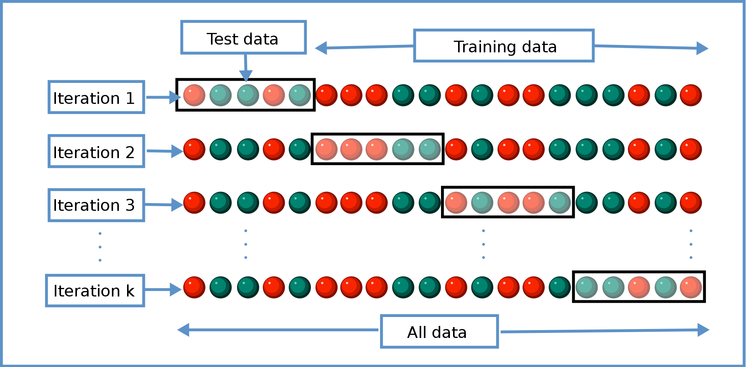
Cross-Validation
Cross-validation is a technique that helps ensure robustness in model evaluation. Instead of a single train-test split, you divide your dataset into "k" subsets or folds of roughly equal size.
You then train and test your model k times, each time using a different fold as the test set and the remaining folds as the training set.
You compute the average performance across all k iterations. Common choices for k are 5 or 10.
Source: Wikipedia: https://en.wikipedia.org/wiki/Cross-validation_%28statistics%29

Slide 80
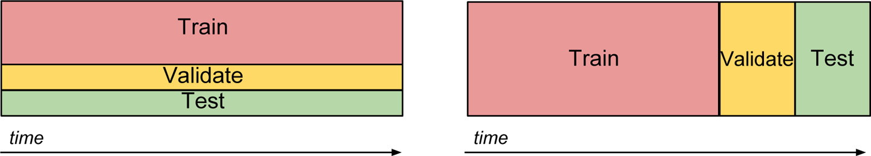
Train/validate/test
The train/validate/test split is a common approach for evaluating machine learning models when you have a sufficient amount of labeled data. It allows you to assess the model's performance, fine-tune hyperparameters, and estimate its real-world performance.

Slide 81
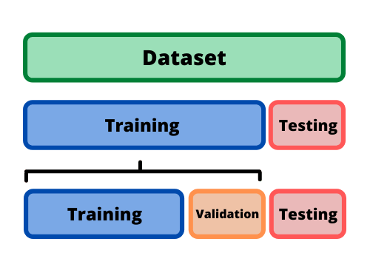
Train/validate/test
Data Splitting:
You start with your labeled dataset, which is divided into three non-overlapping subsets: the training set, the validation set, and the test set.
Typical split ratios are approximately 60% for the training set, 20% for the validation set, and 20% for the test set, but these ratios can vary depending on the size and nature of your dataset.
Training:
You train your machine learning model on the training set. The model learns patterns and relationships within this data.
Validation:
You evaluate the model's performance on the validation set. This evaluation helps you fine-tune hyperparameters, select the best model from a set of candidate models, and monitor how well the model generalizes to unseen data.
If you're conducting hyperparameter tuning (e.g., adjusting learning rates, regularization strengths), you can iterate through different parameter settings and choose the ones that perform best on the validation set.
Testing:
After you've selected your final model and hyperparameters based on performance on the validation set, you assess the model's real-world performance using the test set.
The test set serves as an unbiased estimate of how well your model is likely to perform on unseen data because it has not been used for training or hyperparameter tuning.
Source: https://sdsclub.com/how-to-train-and-test-data-like-a-pro/

Slide 82
Out-of-time validation
Out-of-time validation is a technique used to address the challenge of validating machine learning models when the data distribution changes over time.
In scenarios where the underlying characteristics of your data are evolving, randomly splitting data into training and validation sets from the same labeled dataset may not be representative of real-world situations.
Out-of-time validation seeks to create a more realistic assessment of model performance by introducing a temporal element

Slide 83
Unbalanced data
Dealing with unbalanced data, where one class significantly outnumbers the other(s), is a common challenge in classification tasks.
This scenario often arises when you're working on problems involving rare events, such as fraud detection, disease diagnosis, or equipment failure prediction, where the positive class (rare event) is the minority.

Slide 84
Handling Unbalance
Addressing class imbalance is crucial to ensure that your machine learning model learns to recognize the minority class effectively.
Oversampling the Minority Class
Undersampling the Majority Class
Weighted Loss Function

Slide 85
Missing features
Handling missing features in your dataset is a common challenge in machine learning, as real-world data often contains gaps and inconsistencies.
How you deal with missing features can significantly impact the performance and accuracy of your model.

Slide 86
Handling missing features
1. Removing Samples with Missing Features:
Removing Features with High Missingness:
Imputation with Simple Statistics:
Imputation with Machine Learning Algorithms:

Slide 87
Large events
When dealing with imbalanced datasets in machine learning, where one class significantly outnumbers the other, downsampling is a technique used to balance the class distribution.
In some cases, you may want to downsample large events, which can be advantageous for certain types of analysis or model training.

Slide 88
Attacker evolution
In the context of machine learning security, especially in adversarial environments, it's crucial to adapt to the evolving tactics of attackers.
Attackers continually modify their methods to circumvent defenses, and as a defender, you must respond effectively.

Slide 89
Feature Selection
eature selection is a crucial step in machine learning and data analysis. It involves choosing the most relevant and informative features (variables) from your dataset to build a predictive model or perform data analysis.
Proper feature selection can lead to more efficient models, reduced overfitting, and improved interpretability. See Feature Selection code under Module 4 on GitHub

Slide 90
Overfitting and Underfitting
One problem that can occur with any machine learning algorithm is overfitting: the model you construct matches the training data so thoroughly that it does not generalize well to unseen data.
On the other hand, too simple of a model might also result in poor generalization to unseen data; this problem is called underfitting.

Slide 91
Overfitting
Overfitting is a common issue in machine learning where the model becomes too complex and learns the training data too well.
It essentially memorizes the training data but fails to generalize to new, unseen data.

Slide 92
Underfitting
Underfitting is the opposite problem, where the model is too simple to capture the underlying patterns in the data. It performs poorly on both the training and unseen data.

Slide 93
Regularization to handle overfitting and underfitting issues
To tackle these issues, we use a technique called regularization.
Regularization adds a term to the loss function that quantifies model complexity.
For example, in decision trees, 'Omega(phi)' could represent the number of leaves in the tree.
Trees with too many leaves would be penalized by the regularization term.

Slide 94
LogReg regulization
In logistic regression, regularization is often done using either L2 regularization or L1 regularization.
L2 regularization uses the Euclidean norm of the coefficient vector, while L1 regularization uses the Manhattan distance norm.
L1 regularization is useful because it can make some feature coefficients exactly zero, effectively selecting the most important features.

Slide 95
LogReg regulization
When using regularized logistic regression, feature normalization is crucial. This means transforming features to have a mean of 0 and a standard deviation of 1.
Without normalization, coefficients of different features aren't comparable due to differences in feature scales.
It's essential to choose the right regularization parameters based on experimentation with a validation set. However, be cautious not to overfit to the validation set, as the test set is the ultimate benchmark for model performance.

Slide 96
Clustering
Clustering is a technique used to group similar data points together based on their characteristics or behavior.
In cybersecurity, clustering helps identify patterns in network traffic or activities that might be indicative of malicious behavior.
For example, if someone is attempting to breach a network, they might try multiple times, and clustering can help detect such repeated attempts.

Slide 97
Clustering techniques
K-Means Clustering: This method partitions data into 'k' clusters by finding centers that minimize the distance between data points and these centers.
Hierarchical Clustering: It creates a tree-like structure of clusters, which can be visualized as a dendrogram.
DBSCAN (Density-Based Spatial Clustering of Applications with Noise): This method identifies clusters based on density and can find irregularly shaped clusters.
Mean Shift Clustering: It identifies clusters by shifting toward regions of higher data point density.
Spectral Clustering: This technique uses the eigenvectors of a similarity matrix to perform clustering.
Agglomerative Clustering: It starts with individual data points as clusters and merges them based on proximity.

Slide 98
Evaluating Clustering Results
When we cluster data, it's like grouping things that look alike, but sometimes we don't have a clear answer as to what should go in each group.
In supervised learning, we have labels to tell us if our model is right or wrong. But in clustering, it's trickier because we don't have those labels.

Slide 99
Evaluating Clustering Results
However, when we do have labels (ground truth), we can use metrics like Homogeneity (how well each cluster has only one kind of thing) and Completeness (how well all similar things are in one cluster) to evaluate clustering accuracy.
There's also a combined metric called the V-measure that considers both homogeneity and completeness.

Slide 100
Evaluating Clustering Results
But in real scenarios, we often don't have these labels. So, we use other methods like the Silhouette coefficient and the Calinski-Harabaz index.
The Silhouette coefficient measures how close each point in one cluster is to the points in the neighboring cluster. It gives a score between -1 and +1, where higher is better.
The Calinski-Harabaz index checks if clusters are well separated and dense. A higher score is better.
These methods help us understand if our clustering makes sense even without labels, but they have limitations.

Slide 101
Extra slides for more context

Slide 102
How to tell whether this is a good ML model or not?
The model’s job is to tell whether a transaction is a frau or not, here are the options:
It should successfully classify a fraud as a fraud
Truly Classify the fraud as fraud
It should successfully classify a non-fraud as a non-fraud
Truly classify the non-fraud
It should not classify a fraud as non-fraud
Falsely classify fraud as non-fraud
It should not class a non-fraud as a fraud
Falsely classify non frauds as fraud

Slide 103
Confusion Matrix
A confusion matrix is a table used for evaluating the performance of a classification model.
It summarizes the model's predictions compared to the actual outcomes.

Slide 104
Evaluate a model
We can obtain the Confusion Matrix from each model to evaluate how good the model is
Actual | Predicted
 | Positive Class | Negative Class
Positive Class | TP (True Positive) | FN (False Negative)
Negative Class | FP (False Positive | TN (True Negative)
TP: Truly classify Positive class as Positive
TN: Truly classify Negative class as Negative
FP: Falsely classify the Negative class as Positive
FN: Falsely classify the Positive Class as Negative

Slide 105
Confusion Matrix Elements

Slide 106
True Positives (TP)
TP = Number of correctly predicted positive instances
TP represents the cases where your model correctly predicted something as positive, and it was indeed positive.
For example, if you have a medical test, TP would be the number of times the test correctly identified someone with a disease

Slide 107
True Negatives (TN)
TN = Number of correctly predicted negative instances
TN represents the cases where your model correctly predicted something as negative, and it was indeed negative.
For instance, in spam email detection, TN would be the number of times the system correctly identified non-spam emails.

Slide 108
False Positives (FP)
FP = Number of incorrectly predicted positive instances
FP is the number of times your model predicted something as positive when it was actually negative.
It's like a false alarm in a security system, where it goes off even though there's no real threat.

Slide 109
False Negatives (FN)
FN = Number of incorrectly predicted negative instances
FN represents the cases where your model predicted something as negative, but it was actually positive.
Think of FN as missed opportunities, like failing to detect a problem when it's actually there.

Slide 110
Model Performance Evaluation Metrics
From the confusion matrix, we can calculate metrics to evaluate our model:
Accuracy
Precision
Recall
F1-Score
G-Score
False Positive Rate
Matthew Correlation Coefficient MCC

Slide 111
Accuracy
Accuracy = (TP + TN) / (TP + TN + FP + FN)
Accuracy measures how often your model makes correct predictions overall.
It's like asking, "Out of all the predictions my model made, how many were correct?“
Ranges between 0 and 1, the higher the better

Slide 112
Precision (Positive Predictive Value)
Precision = TP / (TP + FP)
Precision is about how accurate your positive predictions are.
It tells you, "When my model says something is positive, how often is it correct?“
Ranges between 0 and 1, the higher the better

Slide 113
Recall (Sensitivity or True Positive Rate)
Recall = TP / (TP + FN)
Explanation: Recall assesses how well your model can find all the positive instances.
It answers the question, "Out of all the actual positives, how many did my model correctly find?“
Ranges between 0 and 1, the higher the better

Slide 114
F1-Score
F1-Score = 2 * (Precision * Recall) / (Precision + Recall)
The F1-Score combines precision and recall into a single metric, giving you a balance between the two.
It helps you find a middle ground between making precise predictions and catching all the positive cases.
Ranges between 0 and 1, the higher the better

Slide 115
False Positive Rate (FPR)
FPR = FP / (FP + TN)
Explanation: FPR calculates how often your model incorrectly predicts something as positive when it's actually negative.
It's useful for scenarios where false alarms are costly.
Ranges between 0 and 1, the lower the better

Slide 116
Matthews Correlation Coefficient (MCC)
MCC = (TP * TN - FP * FN) / √[(TP + FP)(TP + FN)(TN + FP)(TN + FN)]
Explanation: MCC takes into account all four elements of the confusion matrix and provides a balanced measure of classification performance.
It ranges from -1 (completely wrong) to +1 (perfectly correct), with 0 indicating no better than random.

Slide 117
Understand Model Evaluations
Metric | High Score Interpretation | Low Score Interpretation
Accuracy | Many correct predictions overall | Many incorrect predictions overall
Precision | High likelihood of correct positive predictions | Many false positive predictions
Recall (Sensitivity) | Effective at capturing positive instances | Missing many positive instances
False Positive Rate (FPR) | Many false alarms | Fewer false alarms
F1-Score | Balanced precision and recall | Imbalance between precision and recall
G-Score (G-Measure) | Balance between precision and recall | Imbalance between precision and recall
MCC (Matthews Correlation) | Strong overall performance | Poor alignment with actual outcomes

Slide 118
Understand Model Evaluations
Metric | High Score Interpretation | Low Score Interpretation
Accuracy | Many correct predictions overall | Many incorrect predictions overall
Precision | High likelihood of correct positive predictions | Many false positive predictions
Recall (Sensitivity) | Effective at capturing positive instances | Missing many positive instances
False Positive Rate (FPR) | Many false alarms | Fewer false alarms
F1-Score | Balanced precision and recall | Imbalance between precision and recall
G-Score (G-Measure) | Balance between precision and recall | Imbalance between precision and recall
MCC (Matthews Correlation) | Strong overall performance | Poor alignment with actual outcomes

